Slide 1
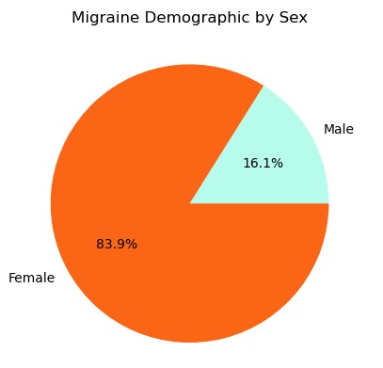
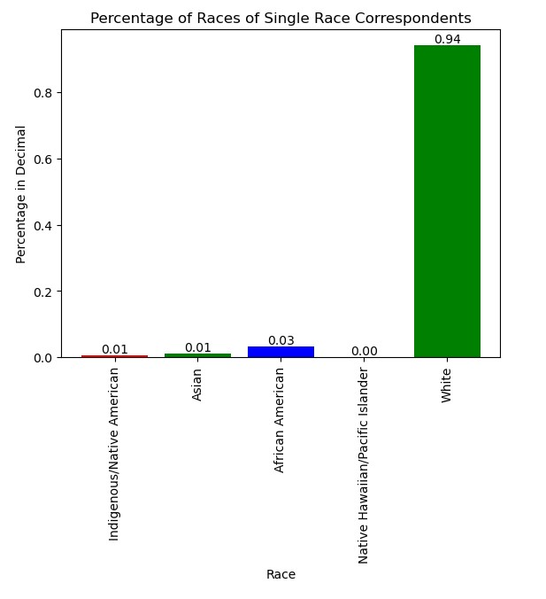
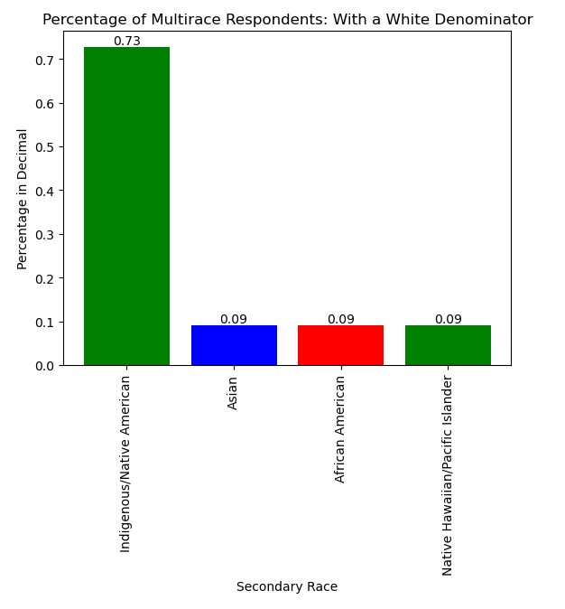


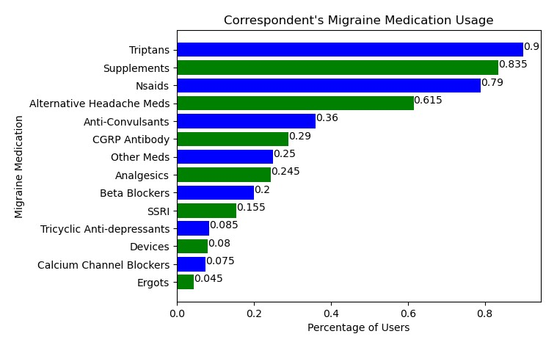
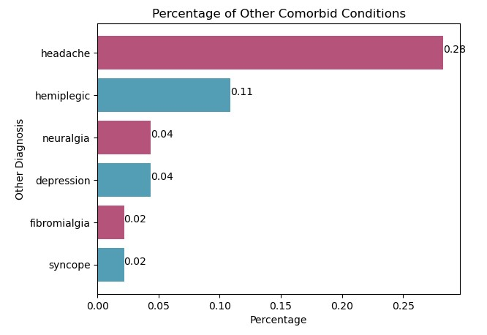
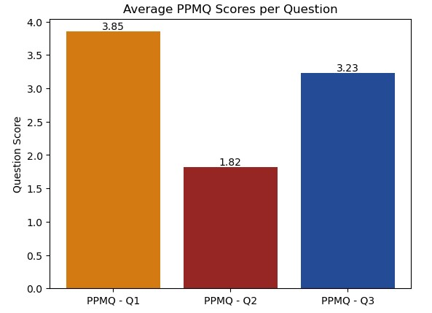
Exploring the Impact of the Neurologic Disease Migraine
And Treatment Efficacy
Nicolas Huang
Migraine is a common neurological disease that afflicts roughly 12 percent of the American Population. Despite being prevalent, it is often a misunderstood disorder by both the public and healthcare professionals. Migraine is a complicated underlying genetic disorder and is usually accompanied by other disorders. Increasing awareness and educating the public may help increase attraction to future studies of the disease, as well as further develop empathetic attitudes towards those affected. Patients with a history of migraine were given an anonymized health survey, which was used as the basis for this study. The Exploratory Data Analysis approach (EDA) was used to analyze the data. This approach made it possible to perform initial investigations of the data, as well as uncover any patterns or anomalies. Through the use of EDA, it was found that many of the participants had a lower quality of life, as well as a high impact on their ability to do certain activities. It was also found that the most common comorbid condition was headaches, hemiplegia, depression, and syncope. The findings of this study will hopefully raise awareness that migraine is a severely complicated neurological disorder. And that it should be treated with the same passion as more visible diseases.
1 in 8 Affected Suffer With More Than One Condition
Migraine Demographic
Chi Square Goodness of Fit
Test
Females Are Disproportionally Affected by Migraine
Institutional Underreporting & Cultural Norms Skew Minority Reporting
U.S Healthcare Impacts Modern Proper Treatment
Diving Deeper into Migraine
Not a Single Package
On Average, Majority of the Study Participants Had Neutral Feelings Towards Their Treatment
Migraine Sufferers – Satisfaction with
Current Treatment
Episodic/Cluster Headaches and Hemiplegia are the Two Most Common Comorbid Conditions
References
Bureau, U. S. C. (2021, December 16). 2018 population estimates by age, sex, race and Hispanic origin. Census.gov. Retrieved April 17, 2023, from https://www.census.gov/newsroom/press-kits/2019/detailed-estimates.html
E;, L. S. S. H. U. L. (2015). The prevalence, burden, and treatment of severe, frequent, and migraine headaches in US minority populations: Statistics from National Survey Studies. Headache. Retrieved April 17, 2023, from https://pubmed.ncbi.nlm.nih.gov/25644596/
Liebler, C. A., & Halpern-Manners, A. (2008, February). A practical approach to using multiple-race response data: A bridging method for public-use microdata. Demography. Retrieved April 17, 2023, from https://www.ncbi.nlm.nih.gov/pmc/articles/PMC2831381/
Masrour, S. (2022, December 6). Spotlight on: Migraine in women: AMF. American Migraine Foundation. Retrieved April 17, 2023, from https://americanmigrainefoundation.org/resource-library/migraine-women/

